Slide 1
Voice assistant using python
PRESENTED BY :
M ABHISHEK SINGH (19M91A0532)
DANISH MIRZA (19M91A0533)
T AKHILESHWAR (19M91A0538)
T VIJAY KUMAR (20M95A0502)
HARSHAVARDHAN GOUD(19U61A0556)

Slide 2
Abstract
Sometimes people need assistance to reduce manual effort . Needed critically incase of physically challenged people.
Voice assistant makes our day to day tasks so much easier
Voice assistants are software agents that can interpret human speech and respond via synthesized voices. Voice assistants help humans in reducing the manual efforts in day to day digital tasks
By keeping that in mind we have developed a assistant which can perform tasks like tell us the time, open a website, get us information about almost anything from Wikipedia, tells us a joke, opens an app .

Slide 3
INTRODUCTION
Voice assistant is a digital assistant which uses Voice recognition,
digital processing algorithms and voice synthesis to listen to
specific voice commands and return relevant information or
perform specific functions as requested by the user.
The main objective of the voice assistant is to allow HANDS
FREE control of our digital devices

Slide 4
voice assistants can do almost anything you might be able to
think of. You can use them to play music, answer your
questions, make phone calls, and even control parts of your
home, such as the lights or thermostat .
Voice assistants are fun, simple to use and incredibly helpful.

Slide 5
Popular commands for any voice assistants include :
1)Open camera
2)Open YouTube
3)Open Google (or any website)
4)Ask for the time
Voice Assistants uses natural language processing and speech synthesis to give us the desired results

Slide 6
FUNCTIONALITY
PYTTSX3:
Pyttsx3 is a cross platform text to speech library which is platform independent. The major
advantage of using this library for text to speech conversion is that it works offline.
Speech Recognition:
Since we’re building an application of voice assistant, one of the most
important things in this is that our assistant recognizes our voice.
Date time:
Date and Time is used to show date and time. This module comes built in with python

Slide 7
Web Browser:
this module is used to perform web search. This module come built in with Python.
Wikipedia:
It is also a python module for searching anything on Wikipedia.
Smtplib: It is a Simple mail transfer protocol that allows us to send mails and to route mails
between mail servers.

Slide 8
SCREENSHOTS

Slide 9
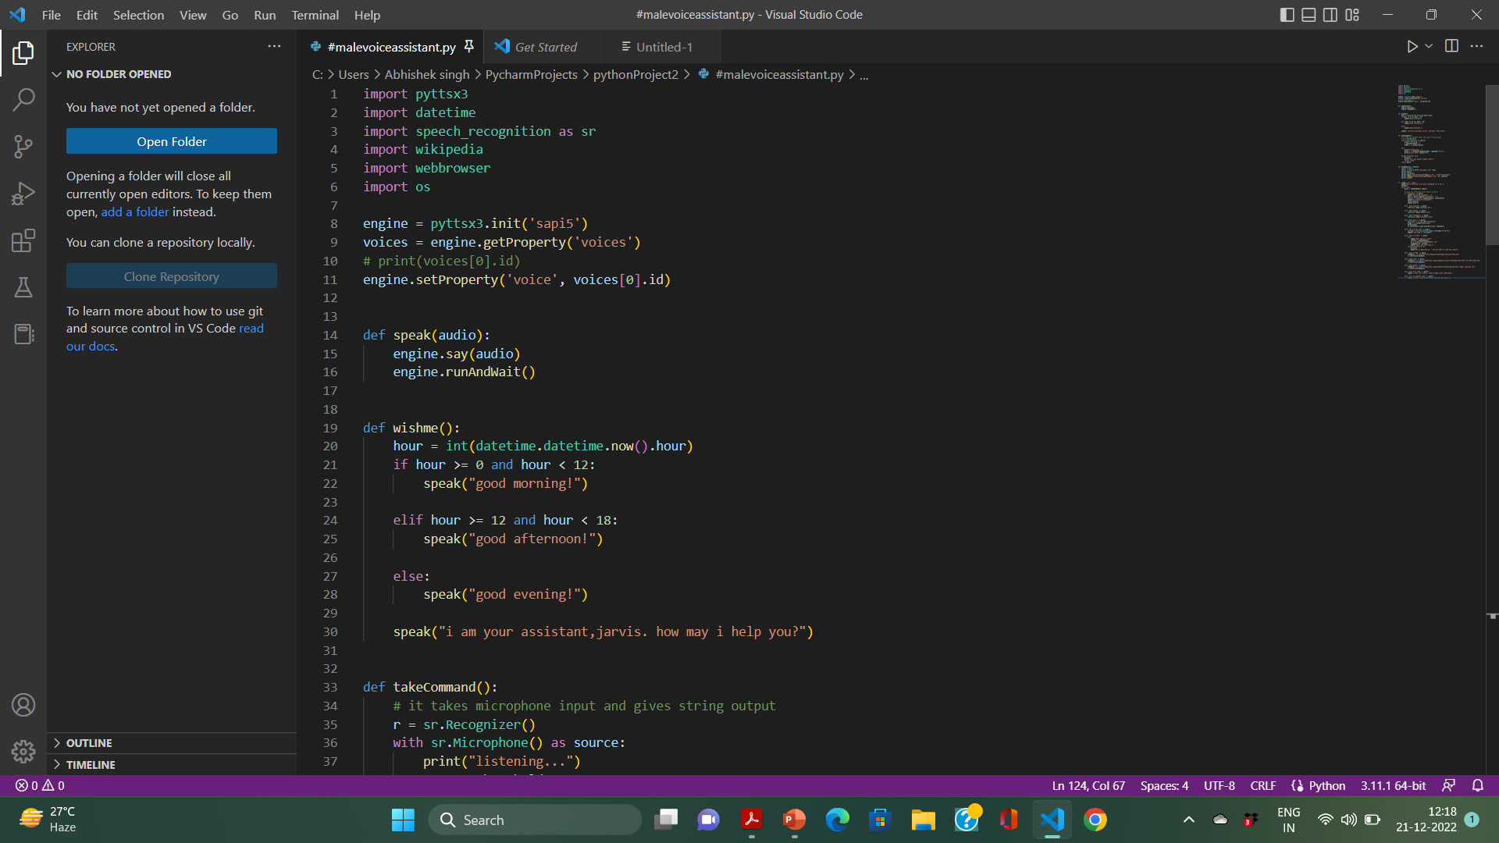

Slide 10
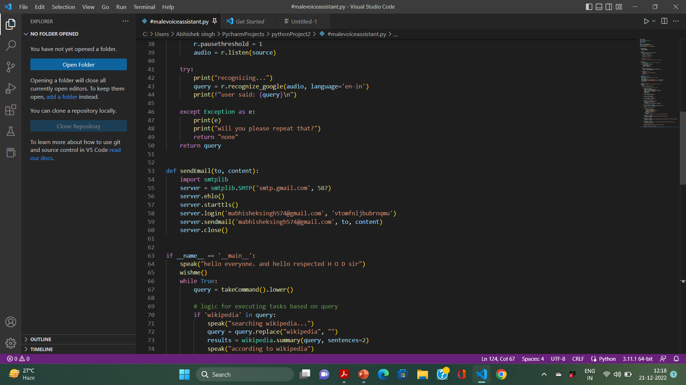

Slide 11
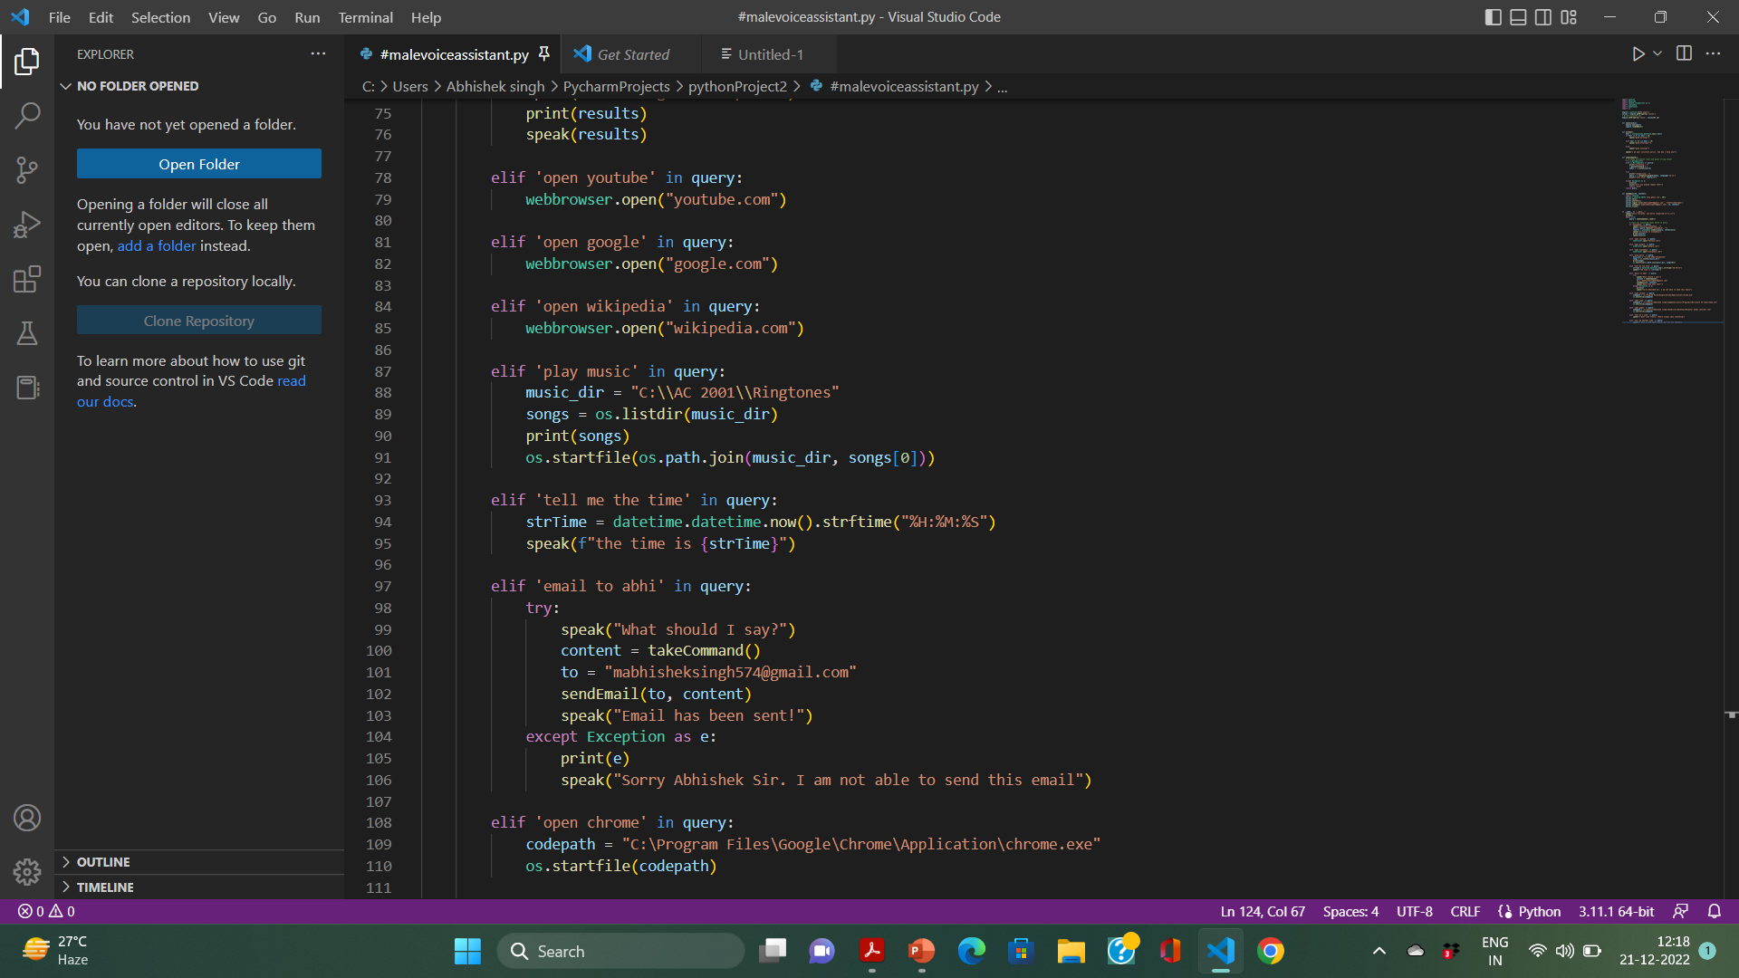

Slide 12
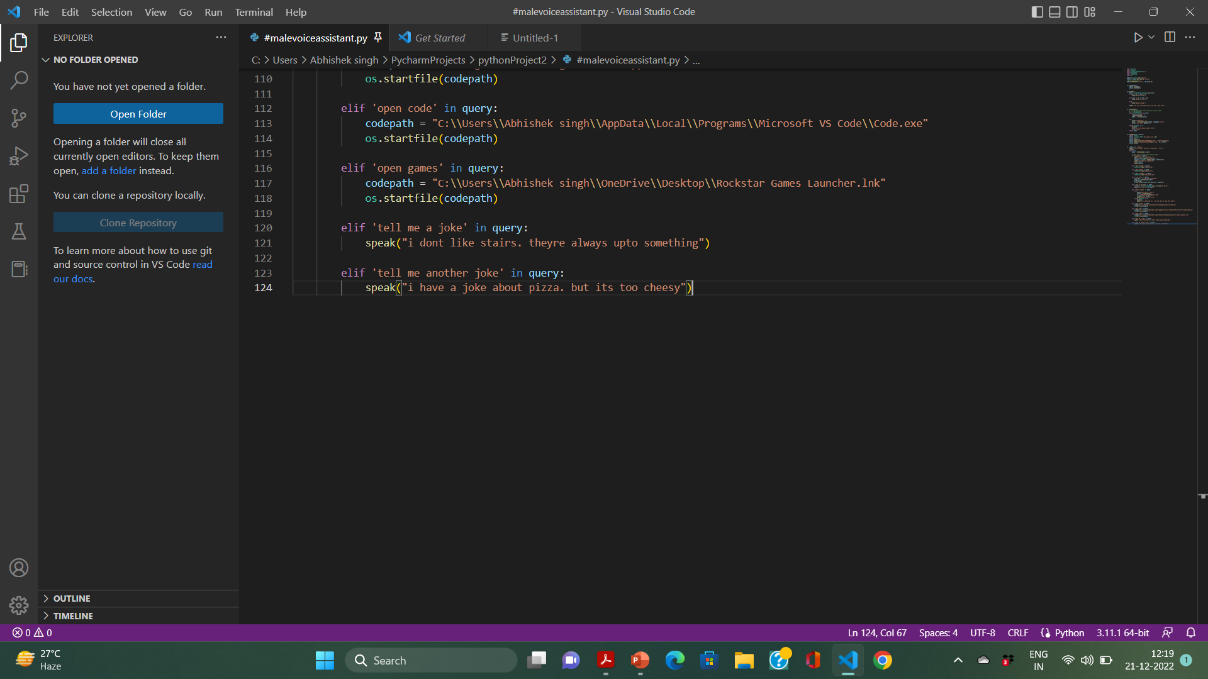

Slide 13
Screenshots output

Slide 14
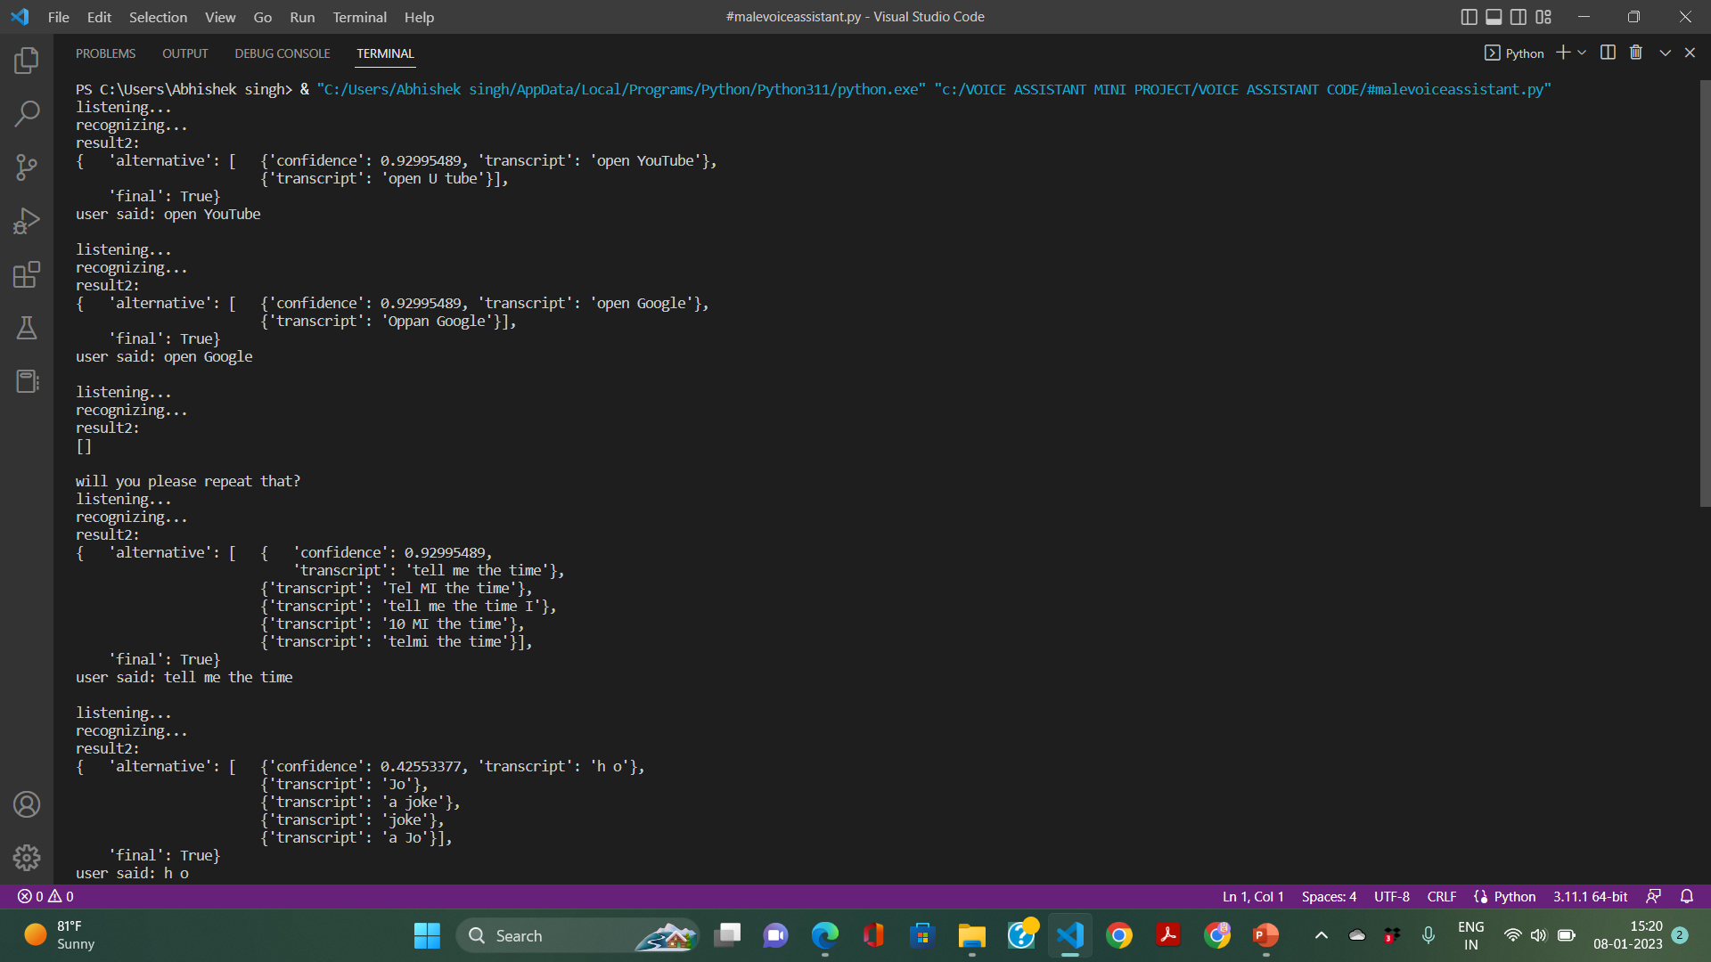

Slide 15
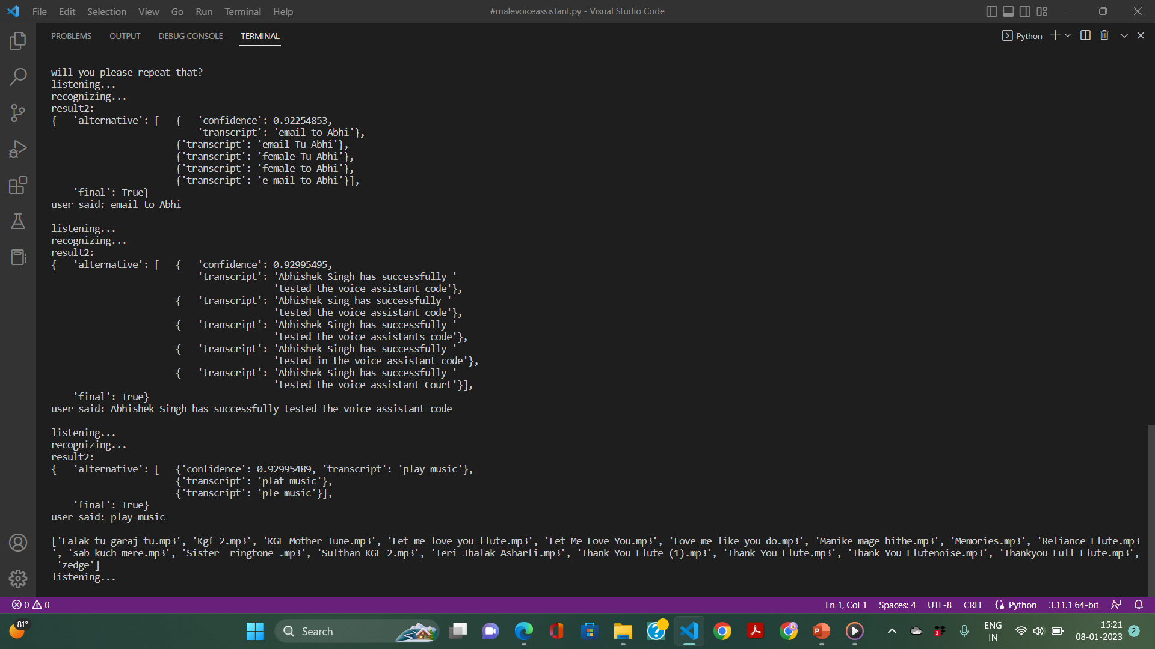

Slide 16
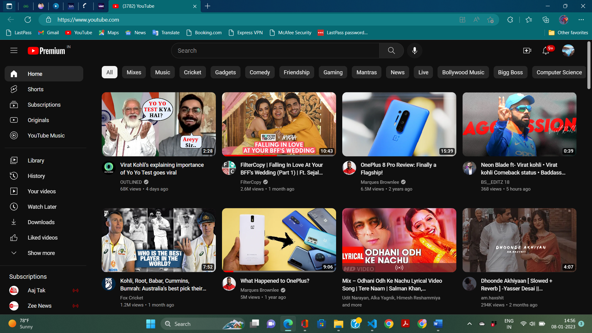

Slide 17
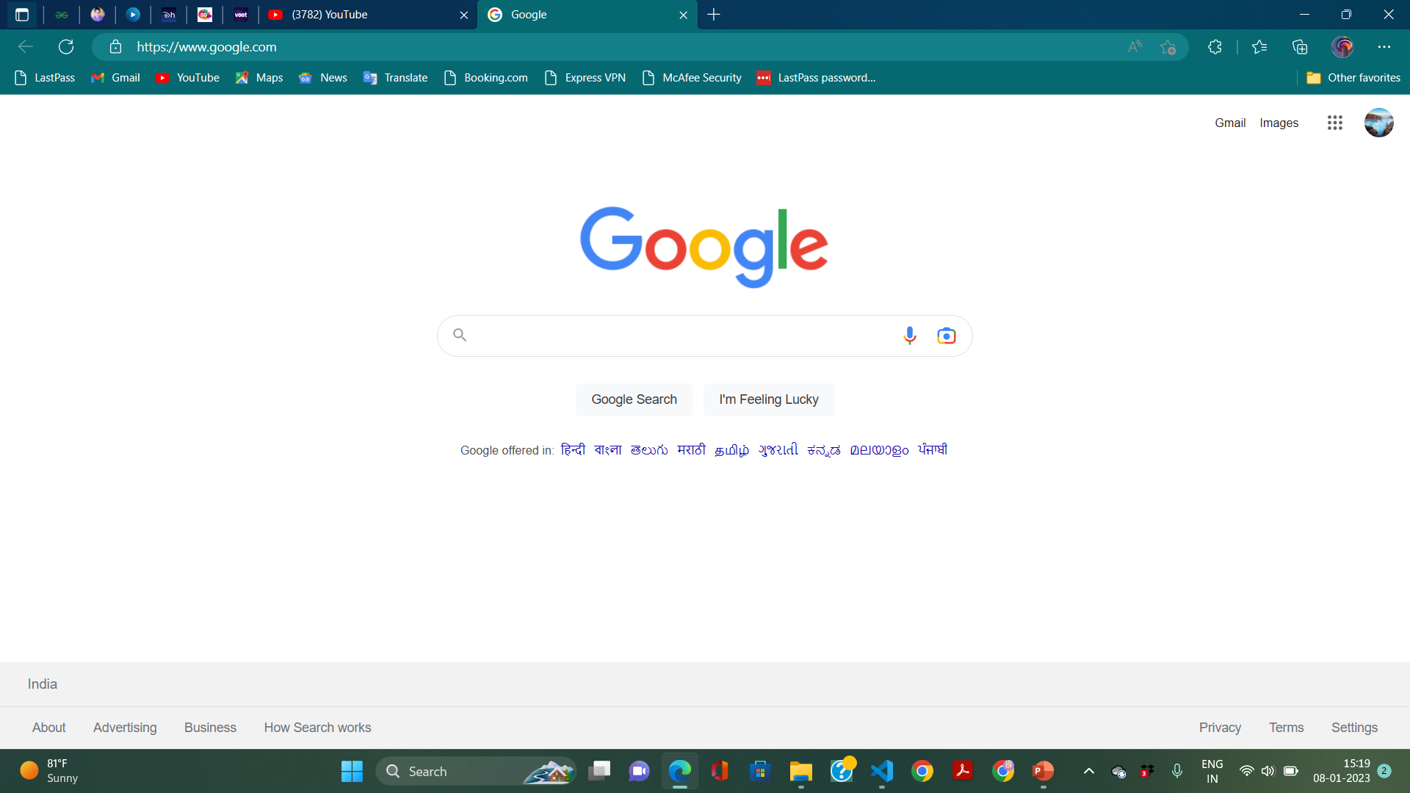

Slide 18
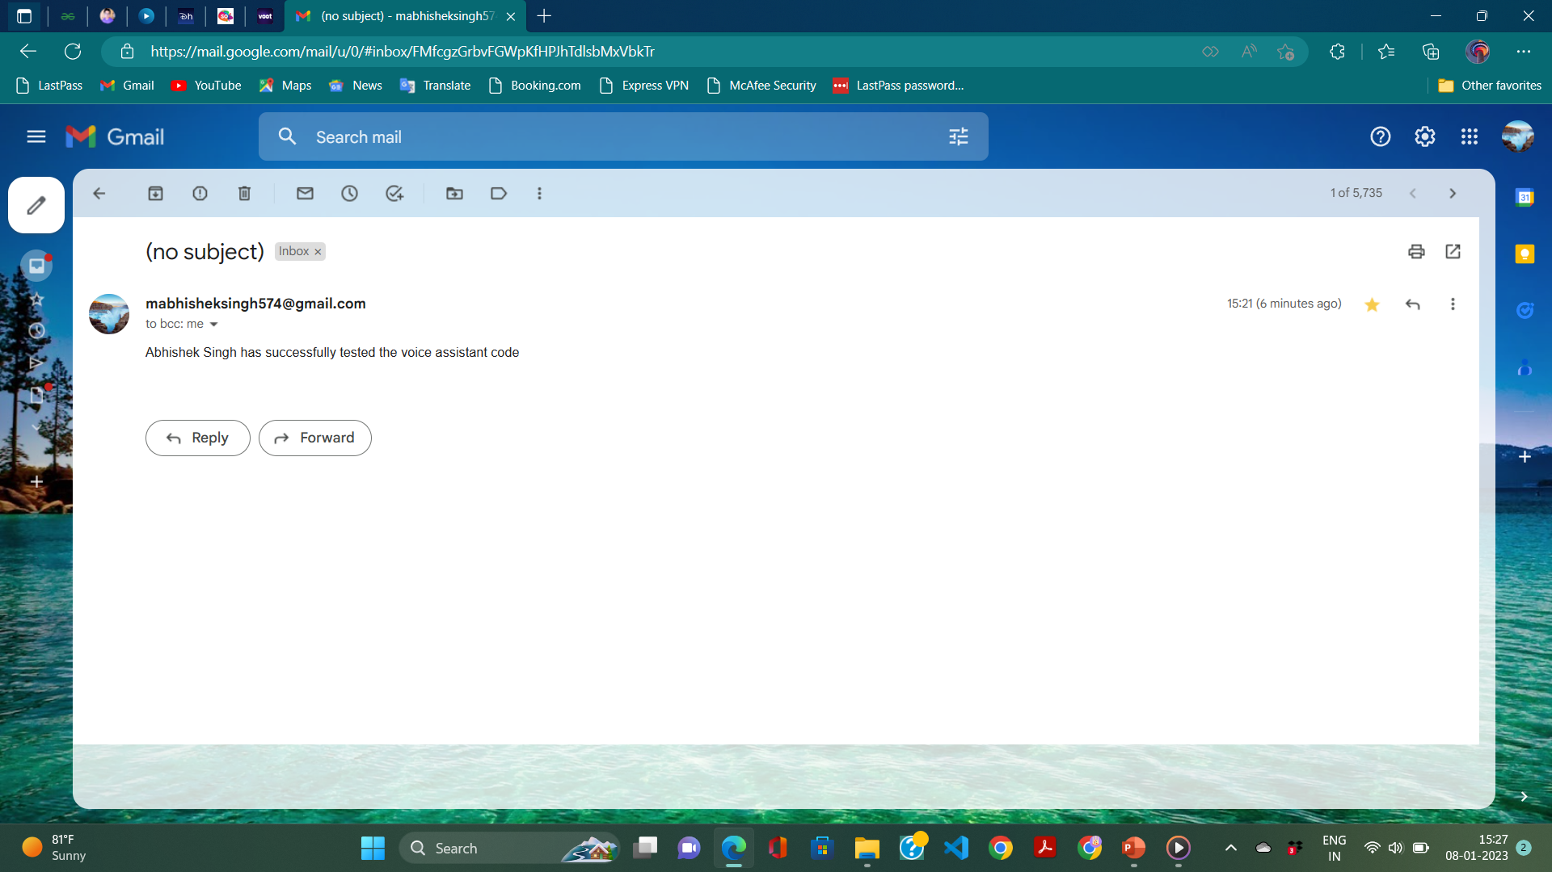

Slide 19
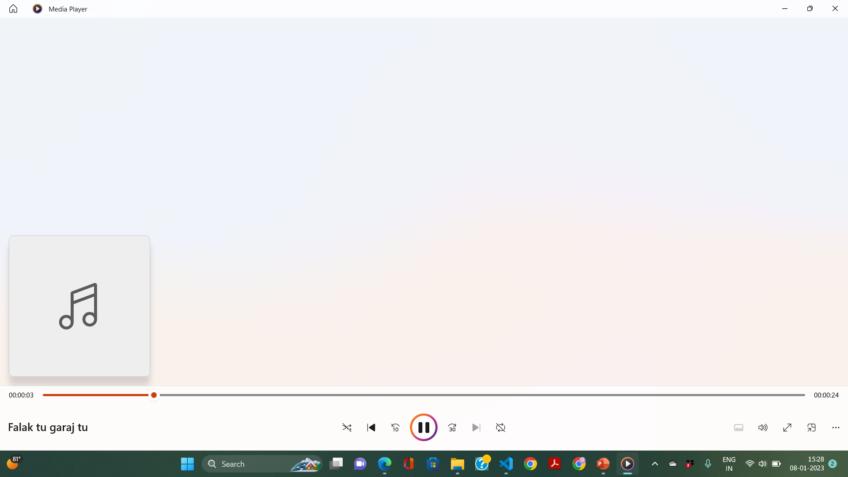

Slide 20
FUTURE SCOPE
In the near future, voice assistants are also expected to take a more proactive role. Rather than just waiting for user commands, assistants will collect context specific information and then take the initiative by making helpful suggestions to the user. For example, people can interact with their in car voice assistants to get information about fuel levels, diagnostics, and service needs or system settings that may need adjustment. So when fuel levels are low, the voice assistant may suggest going to the nearest gas station (with GPS directions if needed).

Slide 21
What’s more, an in
car voice assistant could be connected to intelligent home systems by integrating them with IoT devices or home automation systems. This would enable car owners to turn off the lights and set the alarm after they leave home or turn on the heating before they return.
Soon, voice assistants will also be able to authenticate purchases by recognizing a voice and matching it to a set credit card or bank account. Users will be able to pay for their orders simply by using voice commands the voice assistant would only ask them to confirm the payment.

Slide 22
ADVANTAGES
I. Easy to use
II. Can work with variety of commands
III. Helpful for disabled people
IV. Minimal effort
V. Can store remainders and notes
VI. Can send emails to anyone without actually interacting with
the device physically.

Slide 23
DISADVANTAGES
1) They Make Common Grammatical Errors
2) They Incur High Costs
3) They Make Communication Less Personal
4) Privacy Concerns

Slide 24
CONCLUSION
They are incredibly helpful.
For now, most of us use voice assistants for simple tasks like playing music, creating shopping lists, turning on and off various intelligent devices in our homes, learning about weather and traffic news, or ordering food.
voice assistants are only just now starting to show us their full potential.
Voice assistants are, ofcourse, far from being the perfect solution for every disabled person, particularly if they have speech difficulties. Nevertheless, they present a unique opportunity that many disabled users can take advantage of to overcome everyday challenges and simply make their lives a bit more comfortable.

Slide 25
THANK YOU

